Slide 1

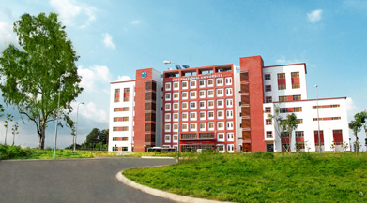
International University
MICRO-PROCESSING SYSTEM
Lecture 0:
Course Introduction
Vo Minh Thanh, M.Eng
School Of Electrical Engineering

Slide 2
International University
School Of Electrical Engineering
MICRO-PROCESSING SYSTEM
Grading Policy:
The overall course grades (letter-grades from 0 to 100) will be assigned based on required standard or overall class distribution. The weights of the assignments and the examinations are:
In-class quizzes, class participation, assignments and learning attitude: 15%
Final Project : 15%
- One midterm exam: 30%
- One comprehensive final exam: 40%
Vo Minh Thanh,M.Eng

Slide 3
International University
School Of Electrical Engineering
MICRO-PROCESSING SYSTEM TOPICS
1. Introduction to microprocessors, Computer, past, present and future technologies
2. 8086 Microprocessor Architecture and Programming
3. AVR, PIC, ARM microcontroller Architecture
4. Microcontroller Assembly Programming
5. High-Level Language Programming for Microcontroller
6. General Input and output / Interrupt
7. Project Proposal : Design Microcontroller-Based Applications
8. Midterm
Vo Minh Thanh,M.Eng

Slide 4
International University
School Of Electrical Engineering
MICRO-PROCESSING SYSTEM TOPICS
9. Timer, counter and PWM
10. ADC/DAC conversion
11. Serial Interfaces ( UART, SPI, I2C)
12. EEPROM Memory Access, Direct Memory Access
13. Controller Area Network (CAN)
14. Final Exam Review
15. Final Project Presentation
Vo Minh Thanh,M.Eng

Slide 5
International University
School Of Electrical Engineering
MICRO-PROCESSING SYSTEM TOPICS
Textbooks and other required materials
* Textbook:
Muhammad Ali Mazidi, “The AVR Microcontroller and Embedded Systems Using Assembly and C”, 2010.
* Reference
- Richard H. Barnett, Sarah Cox, Larry O`Cull, “Embedded C Programming and the Atmel AVR”, Delnmar Cengage Learning Publishing, 2011.
- The AVR Microcontroller and Embedded System, Mazidi, Naimi, and Naimi, Prentice Hall, Copyright 2011, ISBN 0-13-800331-9.
PIC Microcontrollers - Programming in C, Milan Verle, mikroElektronika; 1st edition (2009), ISBN-13: 978-8684417178
The 80x86 IBM PC and Compatible Computers,Assembly Language, Design, and Interfacing M.A. Mazidi and J.G. Mazidi, , 4th edition, Prentice Hall, 2003
Vo Minh Thanh,M.Eng

Slide 6
International University
School Of Electrical Engineering
The End and Thank You.
Any Question?
Vo Minh Thanh,M.Eng

Slide 7
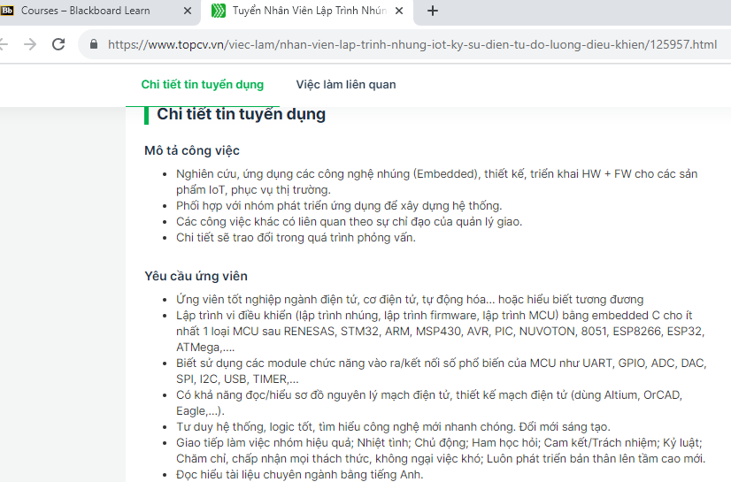
International University
School Of Electrical Engineering
Vo Minh Thanh,M.Eng

Slide 8
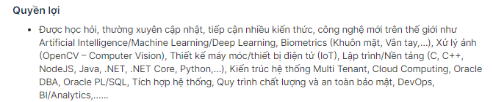
International University
School Of Electrical Engineering
Vo Minh Thanh,M.Eng

Slide 9
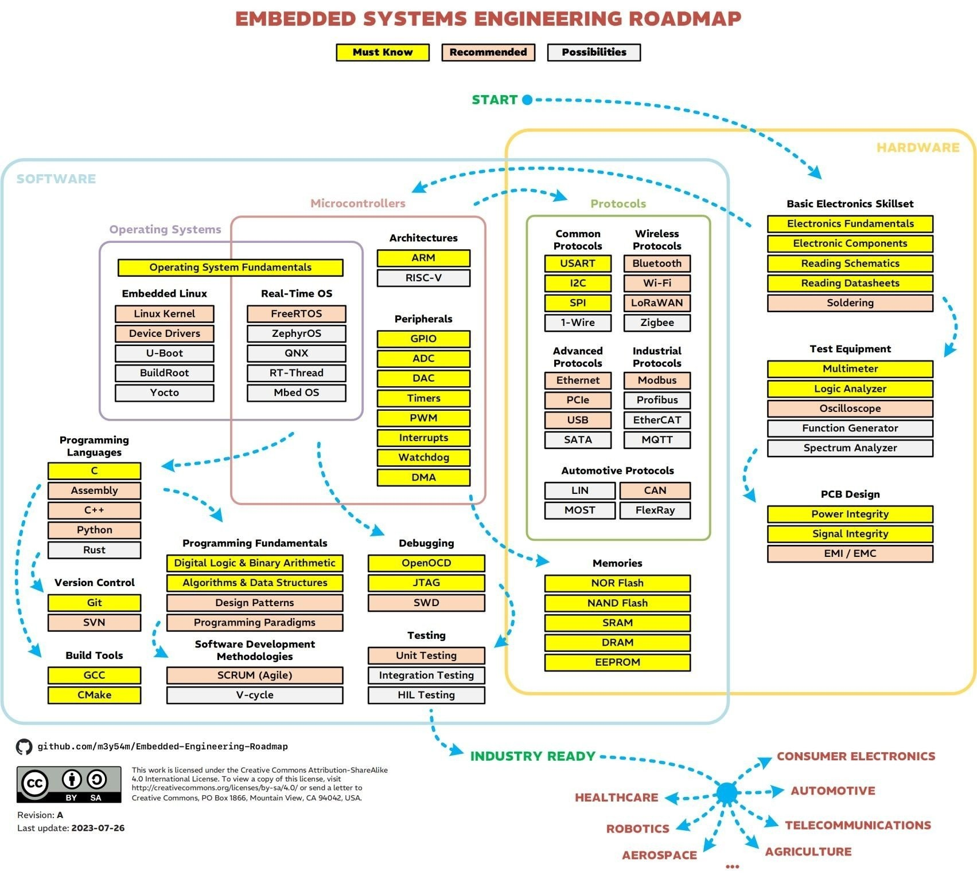
International University
School Of Electrical Engineering
Vo Minh Thanh,M.Eng

